Slide 1

TMDB Box Office Prediction
Portfolio Project by:
Apoorva Kalaskar (DP-2008-OM)

Slide 2
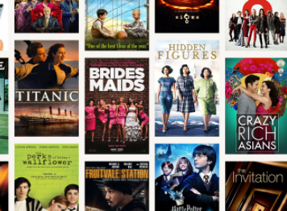
Problem statement
Movies are an integral part of entertainment for all humans in the world.
There is a huge pressure of revenue generation when movies are released.
Having an interface where we can predict the revenue generated by movie which helps to directors, producers, investors to take appropriate decision.
We will be building up a model which predicts revenue based on various factors(discussed ahead).

Slide 3
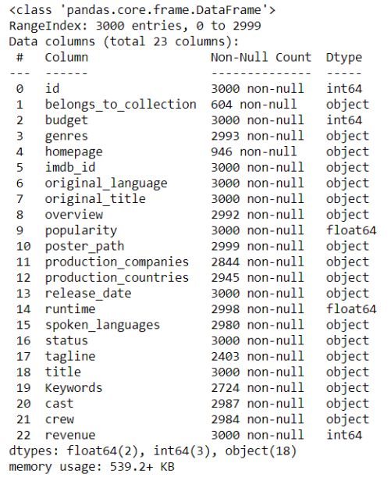
dataset
We have 2 sets of file: Train and Test Dataset
Training Dataset Shape: (3000,23)
Testing Dataset shape: (4398,22)
Attributes: Id, Collection, Budget, Genres, Homepage, Imdb_Id, Language, Title, Overview, Popularity, Poster, Prod Companies, Prod Countries, Release date, Runtime, Status, Tagline, Keywords, cast, Crew, Revenue.

Slide 4
Data processing and model building in python (jupyter notebook)
Univariate Analysis
Visualization
Outlier Treatment
Feature Engineering
Feature Selection
One Hot Encoding
Model Building: MLR and Random Forest
Model Validation and Accuracy
Creation of Pickle File

Slide 5

Model building and results
Multiple Linear Regression
A. All Features – Accuracy 63.82%
B. Cross Validation – Accuracy 55.66%
C. Extra Tress Regressor – Accuracy 63.82%
D. Regularization Techniques -> L1 Regularization 63.82% and L2
Regularization 60.02%
Random Forest
A. All Features -> 94.18%
B. Extra Tress Regressor -> 94.19%
C. GUI Feature Selection -> 93.92%

Slide 6
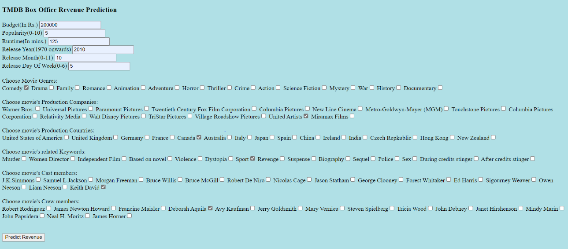

Box office revenue prediction gui

Slide 7
Thank You!

